Slide 1
Protein
Notes:
Ideas, amino acid content in various foods

Slide 2
Quiz Question 1
What is the major difference between proteins and carbohydrates?
Only carbohydrates can be used for energy
Only proteins are absorbed in the small intestine
Only carbohydrates can be stored
Proteins contain nitrogen, this is rare for carbohydrates

Slide 3
Quiz Question 2
What method is not used to study amino acid requirements in humans
Indicator Amino Acid Oxidation
Direct Amino Acid Oxidation
Nitrogen Balance
Indirect Calorimetry

Slide 4
Quiz Question 3
Tyrosine is synthesized from the essential amino acid phenylalanine. That makes it a…
Essential Amino Acid
Conditionally Essential Amino Acid
Non-Essential Amino Acid

Slide 5
Midterm Results
Mean 79%
Median 83%
Notes:
3 people under 60

Slide 6
Current Overall Grades
Mean 79%
Median 82%

Slide 7
The Protein Macronutrient Unit
Date | Topic | Instructor
Wednesday 10/19 | Introduction to Proteins | Bridges
Monday 10/24 | Digestion and Transport | LaBarre
Wednesday 10/26 | Protein and AA Synthesis | Bridges
Monday 10/31 | Amino Acid Degradation | Bridges
Wednesday 1/2 | Interorgan AA Metabolism | Anderson
Monday 1/7 | Synthesis of Non-Protein Compounds from AA | Anderson
Wednesday 1/9 | In Class Review | LaBarre
Monday 1/14 | Protein Exam
I will be out of town from Nov 1-Nov 13
Will be available via email/video chat if necessary

Slide 8
Protein Structure and Properties Learning Objectives
Understand the basic structure of protein
Identify the property that makes an amino acid different from another
Describe different functional roles of protein
Differentiate between the different classifications of amino acids
Understand how nonessential amino acids can become essential

Slide 9
Is glucose an essential macronutrient?
Yes
No

Slide 10
Protein is an Essential Macronutrient
Deficiencies in protein, not calories: kwashiorkor
Distended abdomen
Fatty liver
Hair, teeth loss
Anorexia
Physical and Mental Development
Deficiencies in protein and calories: marasmus

Slide 11
What is Protein?

Slide 12
Proteins
Exogenous protein sources:
Plant products (grains, legumes, vegetables)
Animal products (meat, poultry, fish, some dairy)
Endogenous protein
Body’s amino acid pool

Slide 13
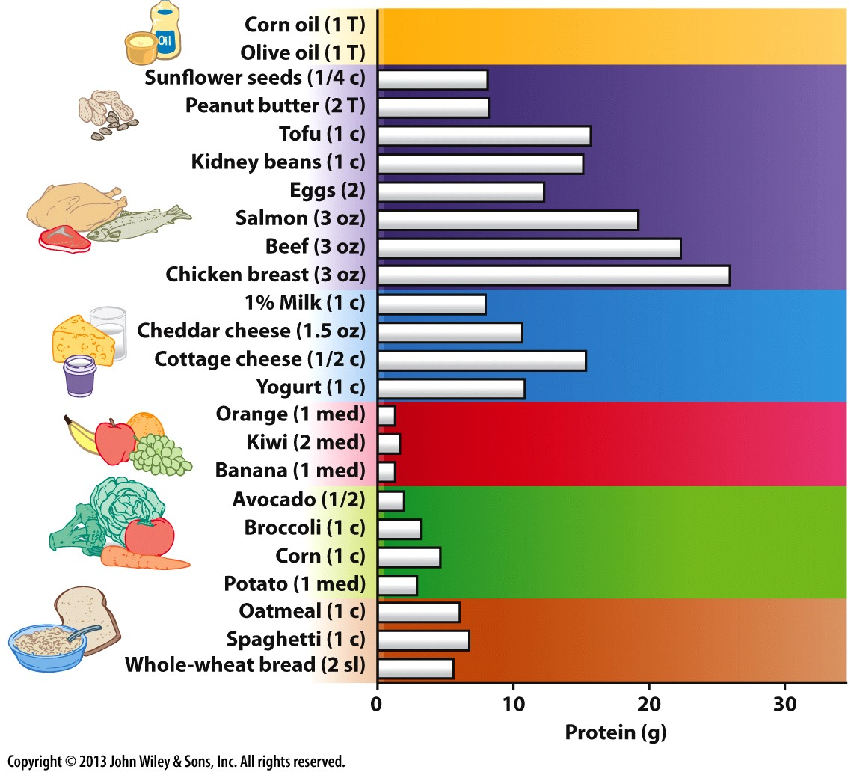

Slide 14
Amino Acid Composition Assignment
In groups of 4-5 (assigned by canvas)
Submit through canvas: Due midnight Sunday night
Pick a food that you think is a good source of protein. Can’t do any of the ones in Table 1.3 of the textbook.
Figure out how many grams of protein are in each gram of that food, citing your sources
Calculate the concentration of amino acids per gram of protein (in umoles/g of protein). Use Table 1.2 of the textbook for molecular weights
Is this a complete protein source or is it lacking in one or more amino acids?

Slide 15
Endogenous Proteins in Mammals
Enzymes, transport proteins, transcription factors etc.
These are required for the normal functioning of the cell
50% of proteins in humans are:
Collagen
Actin
Myosin
Albumin (60% of blood protein)
Notes:
Range in size from 2AA (dipeptide) to Titin (33,000)

Slide 16
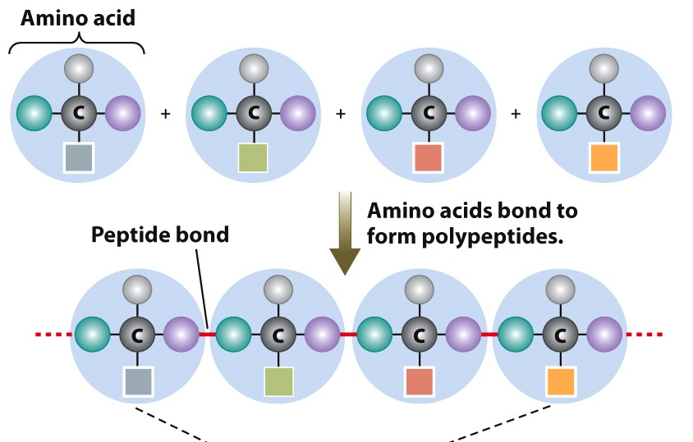
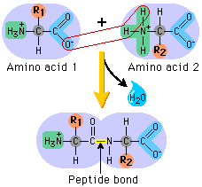
Proteins
Polypeptides – amino acids linked by peptide bonds
Number and type of AA differ among proteins
Notes:
Amin

Slide 17
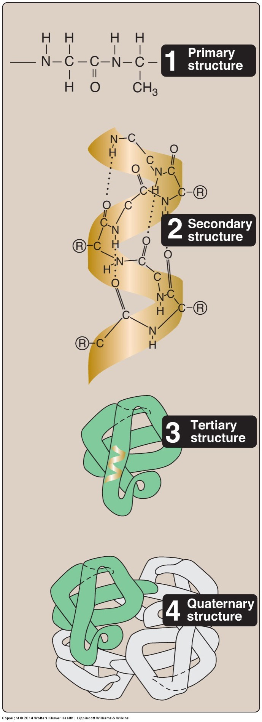
Protein Structure
4 main levels of organization
Primary: Sequence
Secondary: Helices/Sheets
Tertiary: Folds
Quaternary: Multiple Proteins

Slide 18
Proteins are The Source of Food Allergies/Insensitivities
Common food allergens include
Peanuts
Milk (not Lactose intolerance)
Tree Nuts
Fish
Shellfish
Soy
Wheat (ie Gluten)
Affects 4-5% of the population

Slide 19
Proteins are Made of Amino Acids (AA)
Proteins made up of amino acids
20 common amino acids
Central alpha carbon
Made of 4 functional groups:
Amino (-NH₂) – contain Nitrogen
Carboxylic acid (-COOH)
Hydrogen (-H)
Side chain (-R)
H
|
H₂N – C – COOH
|
R

Slide 20
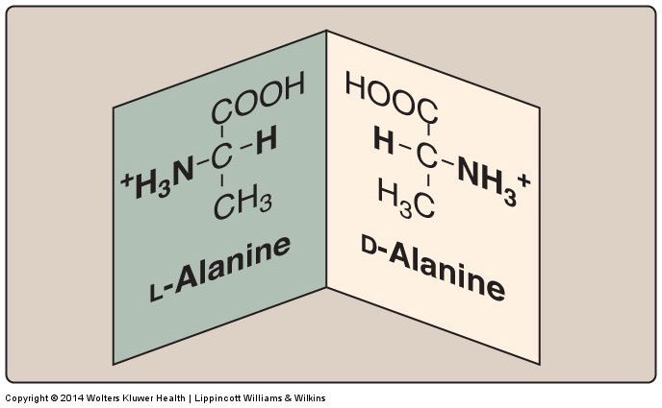
Proteins are Made with Amino Acids
L (left) and D (right) conformations - most metabolic machinery specific to L conformation of amino group
Notes:
Levorotory, dextrarotatory

Slide 21
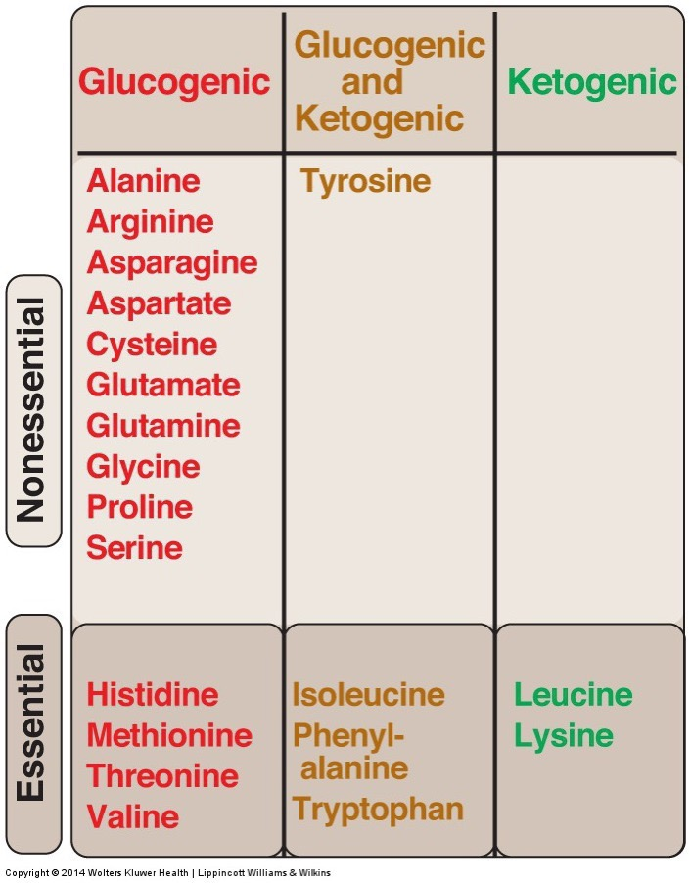
Amino Acid Classifications
Physical Properties (Hydrophobic/Acidic etc)
Biosynthesis (Essential, Nonessential, Conditionally Essential)
Metabolism (Glucogenic, Ketogenic)

Slide 22
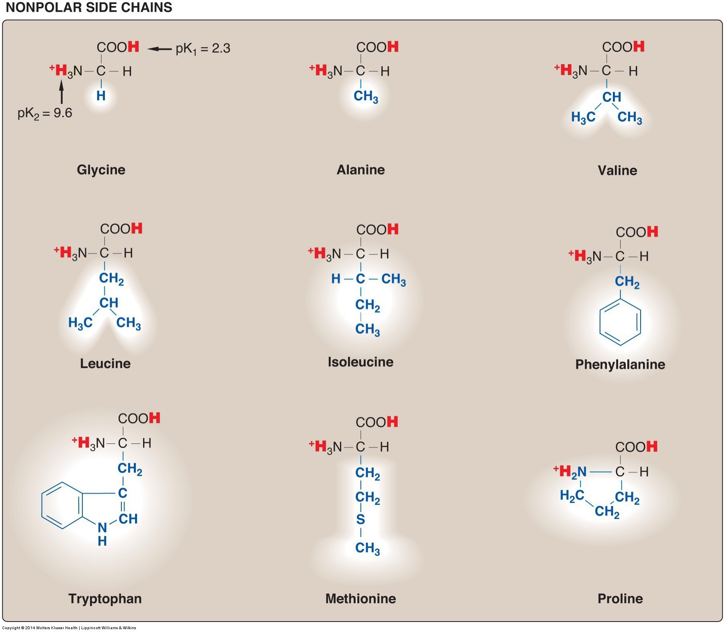
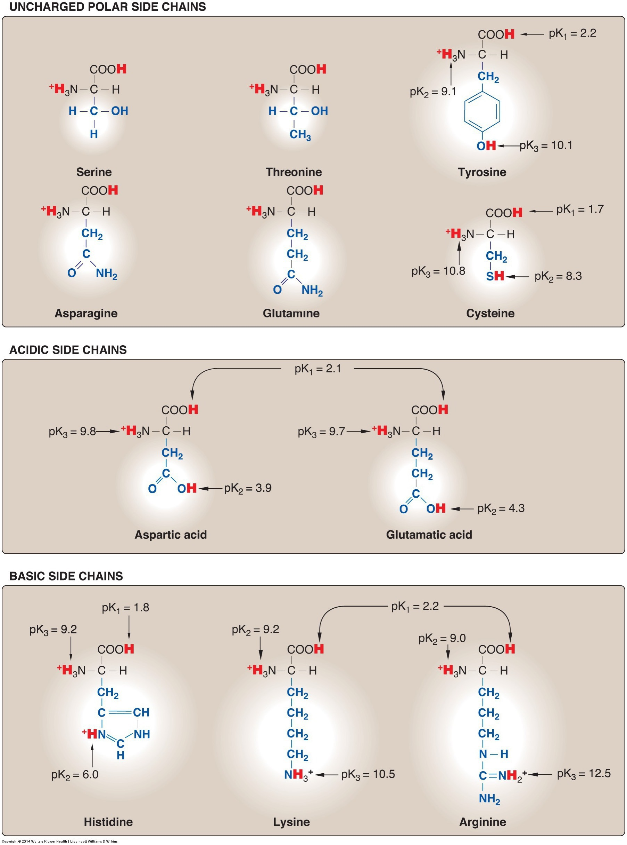
Amino Acids: Physical Properties
Side chains of polypeptide give protein a unique function:
Hydrophobicity
Charge
Positive or negative
Aromatic rings
Hydroxylic group
Sulfur atoms

Slide 23
Amino Acid Classification: Essentiality
Essential – nutritionally necessary
Nonessential/Dispensable – synthesized de novo (in the body)
Conditionally essential – may need from diet due to physiological circumstances
Premature newborn – immature liver
Genetic disorders

Slide 24
Why are some amino acids essential?

Slide 25
How Do We Know What is Essential?
It was known that using corn zein protein to feed rats this restricted growth so other AA are needed
Purified and added back all 19 known amino acids, growth restricted
First identification of threonine
Repeated this with graduate students, this determined the recommended daily intake of the essential AA’s
Notes:
The diets consisted of corn starch, sucrose, butter fat from which the protein had been removed, corn oil, inorganic salts, the known vitamins, and mixtures of highly purified amino acids. The only variables allowed, other than when changes were purposely made in the amino acids consumed, were distilled water and celluflour, a product that provided bulk but had no nutritive value, nitrogen, or flavor. The only unusual component of this otherwise bland diet was a large brown candy containing a concentrated liver extract as a possible source of unknown vitamins, sweetened with sugar and flavored with peppermint oil, which provided a never-to-be-forgotten taste.

Slide 26
Grad School!
“In further investigations with Illinois graduate students as subjects, who were grateful in those days for the free rations, the dollar a day they were paid, and the prospect of seeing their initials in print in Rose’s widely read publications, Rose made many other significant findings.”

Slide 27
Essential Amino Acids Mnemonic

Slide 28
Amino Acid Classification: Conditionally Essential
Precursor | Non-essential Amino Acid
Phenylalanine | Tyrosine
Methionine and Serine | Cysteine
Glutamate | Proline
Glutamine, Aspartate | Arginine
Glutamate | Glutamine
Notes:
Transition to talking about tyrosine

Slide 29
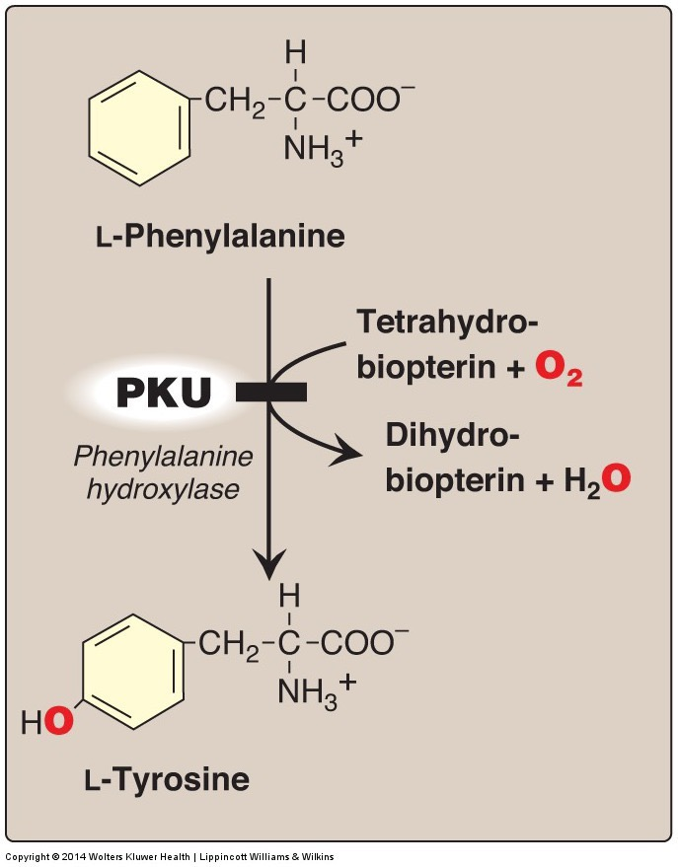
Case Study - PKU
Scenario:
Phenylketonuria (PKU) is genetic disorder resulting in an enzyme deficiency of phenylalanine hydroxylase
After displaying 2 episodes of seizures, a symptom of PKU, Bobbie was diagnosed with PKU
Do you think Bobbie can treat this disorder? How?
Notes:
Think about his diet, the concept of essential vs nonessential amino acids
Do they need no Phe?
Is Tyrosine Essential for Bobbie?

Slide 30
More about PKU
How would you monitor treatment efficacy?
Can Bobbie be treated with a Phe-fre diet?
Is Tyrosine essential, nonessential or conditionally essential for Bobbie?

Slide 31
Amino Acid Classification: Essentiality
Phenylalanine (essential) → Tyrosine (nonessential)
Phenylketonuria (PKU) – genetic disorder of enzyme phenylalanine hydroxylase (1/12,000 individuals)
Inability to convert phenylalanine to tyrosine
Phenylalanine builds up
Tyrosine is deficient
Adverse outcomes: seizures, hyperactivity, mental retardation, death
Treatable
Diet low in phenylalanine and high in tyrosine
Tyrosine supplements (“protein substitute”)
Newborns are screened for PKU in all 50 states

Slide 32
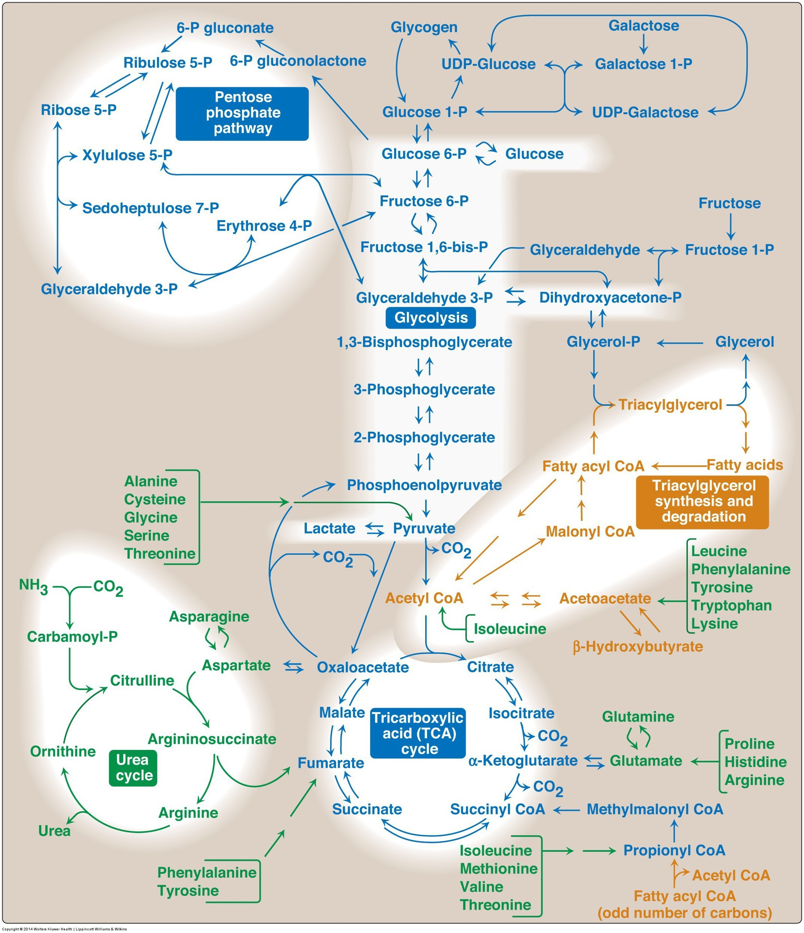
Classification of Amino Acids by Metabolism
Synthesis of glucose, lipids or generation of ATP
What can alanine become? If so under what conditions?
What can leucine become? If so under what conditions?

Slide 33
The Ketogenic Amino Acids
Mnemonic:
F - Phenylalanine
L - Leucine
L - Lysine
I - Isoleucine T - Threonine
T - Tryptophan

Slide 34
Protein Structure and Properties Summary
Proteins are necessary for bodily functions
Hormones, enzymes, transporters, immune functions
Made up of amino acids (building blocks of protein
Amino acids bonded by peptide bonds
Amino acid functions differ according to their side chains
Also contain an amino, carboxylic, and hydrogen group
Nonessential AAs can become essential in given physiological state

